Slide 1


Our Dakota Dreams
YOUR GUIDE TO COLLEGE & BEYOND
ourdakotadreams.com

Slide 2
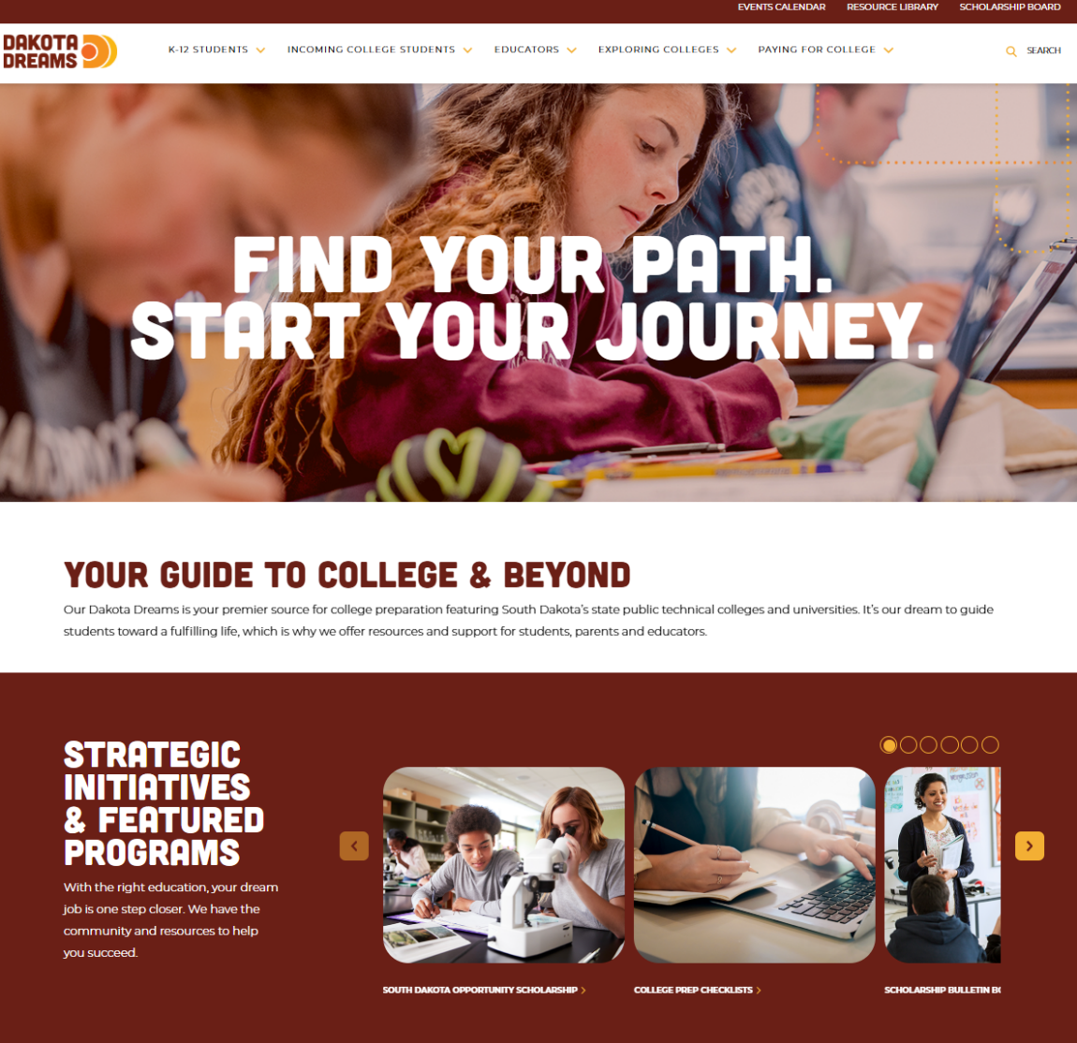
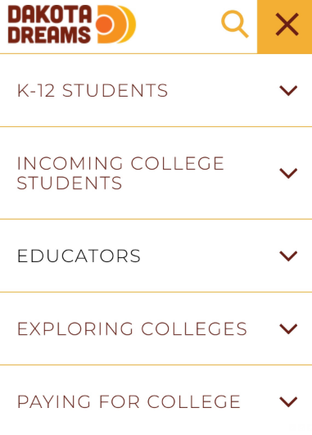
ourdakotadreams.com
Notes:
Our Dakota Dreams strives to be the premier source for college prep information in SD for students, families and their advisors.
Effort is led by a coalition of stakeholders including:
SD Board of Regents & public universities
SD technical colleges
SD Dept. of Education
SD Dept. of Labor & Regulation
Mapping Your Future
At a high level, ODD does three things:
Features grant programming & college prep initiatives
Leads communication campaigns (promoting efforts such as the free college app period, FAFSA completion)
Provides website resources on ourdakotadreams.com
The homepage of ourdakotadreams.com is shown on the screen.
Navigate website by either selecting:
Audience type:
K-12 Students
Incoming College Students
Educator
Or action:
Exploring Colleges
Paying for College

Slide 3

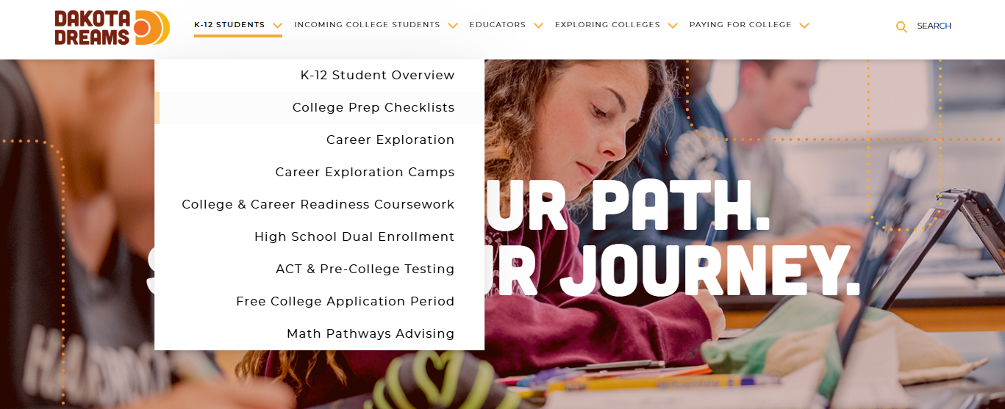
Highlights: K-12 Students
Have a resource request?
LET US KNOW!
ourdakotadreams.com
Notes:
There are a few sections of the website we’d like to highlight today.
The first is the K-12 Students section.
While I’m not going to go into detail about every item under this headers, each have value, so I encourage you to explore.

Slide 4

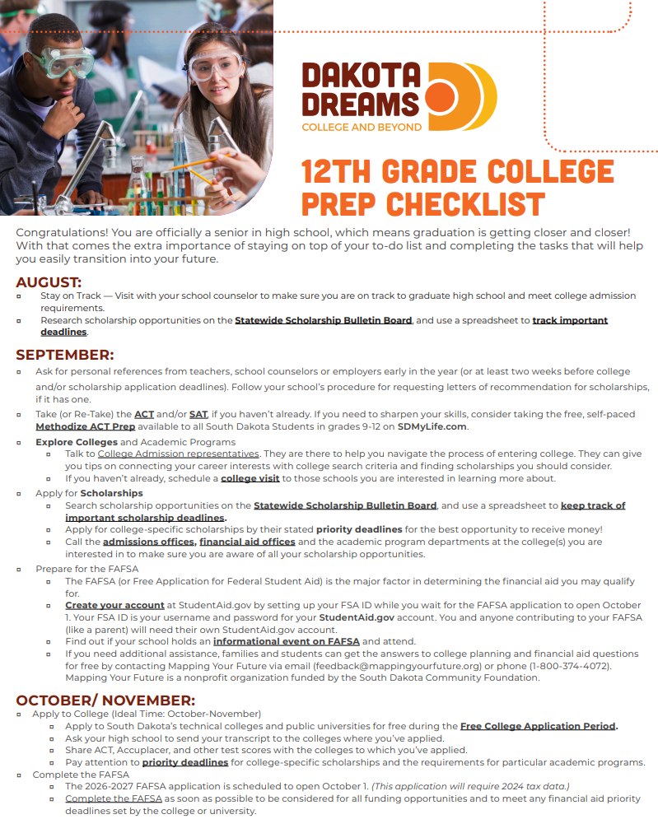
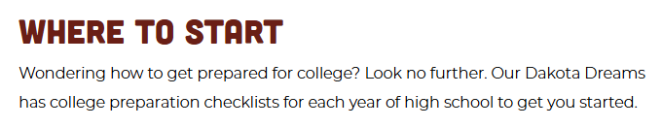
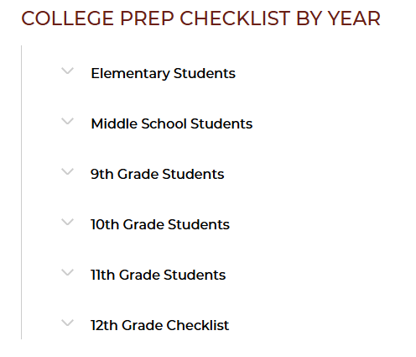
College Prep Checklists
Have a resource request?
LET US KNOW!
https://ourdakotadreams.com/k12-students/getting-started-checklists/
Notes:
A good place to start on ourdakotadreams.com are with the year-by-year College Prep Checklists.
These checklists aim to keep students on-track and thinking strategically about how to prepare for college while saving time and money in the process.

Slide 5


Earn High School & College Credits Simultaneously
Pay Half the Cost for College Courses
Find Courses, Deadlines & Applications
Learn about Gateway Certificate Programs
https://ourdakotadreams.com/k12-students/dual-credit/
Notes:
Students can find High School Dual Enrollment information on the K-12 Students section of the website.
This webpage outlines the discounted High School Dual Credit program students can use to earn high school units and college credits simultaneously…
While paying only half of the usual tuition rate for college credits. That a 50% savings!
On this page, you’ll find HSDC course catalog, deadlines and applications.
You can also learn about HSDC Gateway Certificate programs.

Slide 6
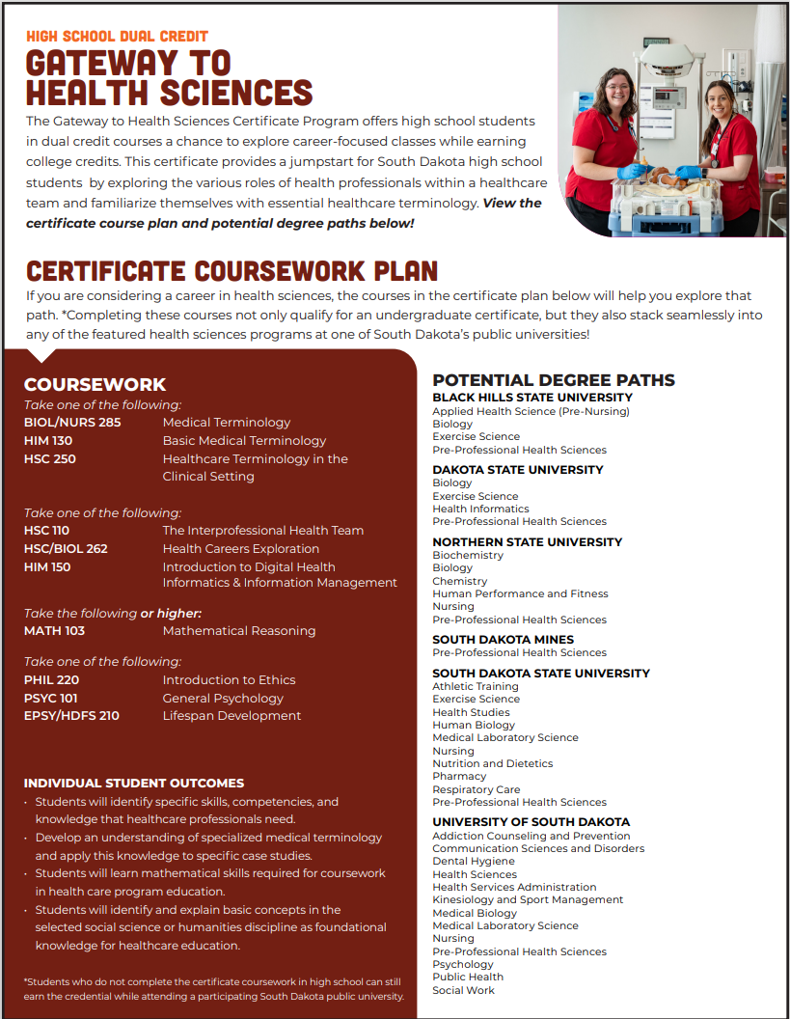
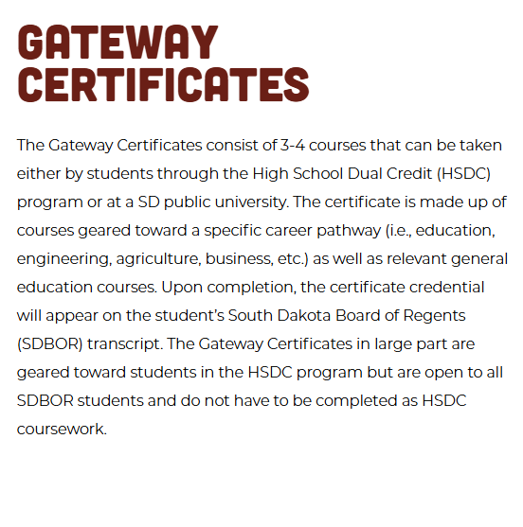
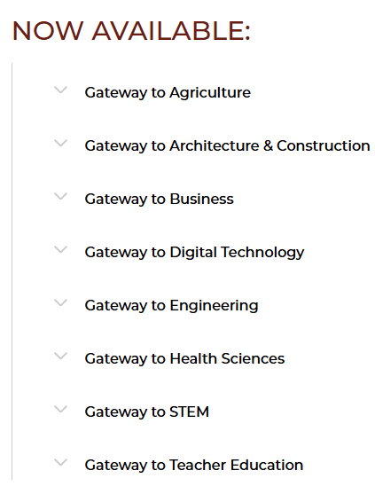
Have a resource request?
LET US KNOW!
Notes:
Gateway Certificates provide students a meaningful way to explore careers.
Gateway certs consist of 3-4 HSDE courses designed to help HS students explore career interests in:
Agriculture
Architecture & Construction
Business
Digital Technology
Engineering
Health Sciences
STEM
Teacher Education
These courses are broad enough that if a student decides the gateway certificate career area is not for them, the credits will easily satisfy other general education or elective requirements in another career area.
Students are not required to complete the Gateway Certificate courses through HSDC – they can continue satisfying requirements while enrolled at a SD public university.

Slide 7

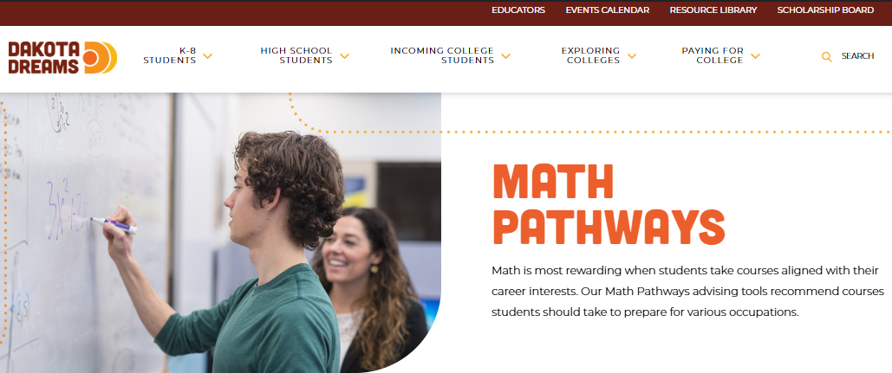
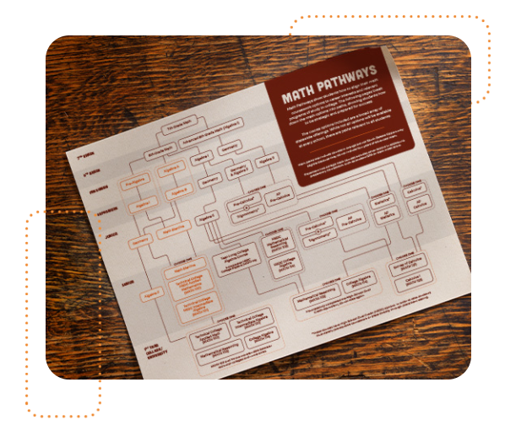

New!
Math Pathway Advising
Learn likely first-year college math course based on career interest.
Advice on math courses to prepare for success in college math course.
Strategic recommendations include:
  4 years of high school math
  SDOS eligibility
  HSDC coursework, when possible
ourdakotadreams.com/math-pathways
Notes:
New Math Pathways Advising Tools can also be found under K-12 students on OurDakotaDreams.com.
These tools help students identify their likely first-year college math course based on career interests.
So, if you want to know your college math target – and get recommendations on how to prepare for success – take a look at these math pathway advising tools.
Recommendations strive to help students be strategic, by
Suggesting 4 years of high school math (statistically, students are more successful in college if they take 4 years of HS math)
Supporting SD Opportunity Scholarship eligibility (this scholarship provides eligible students up to $7,500 for college)
Recommending HSDC coursework, when possible (this saves you time and money)

Slide 8
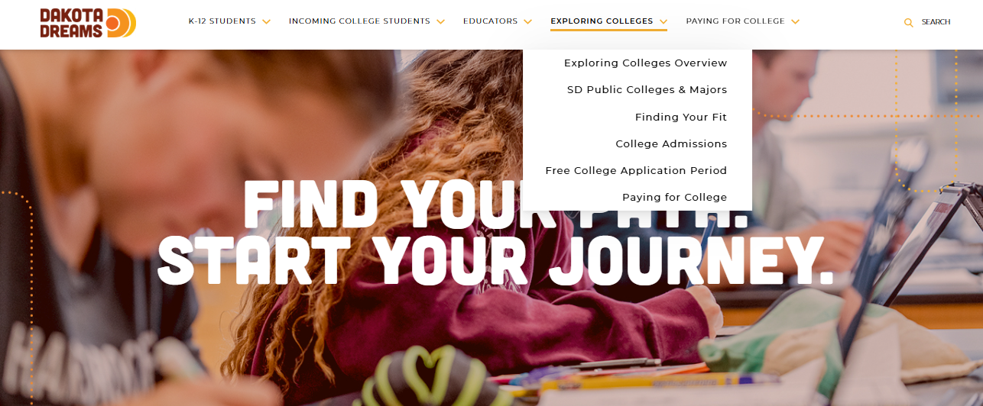
Highlights: Exploring Colleges
Have a resource request?
LET US KNOW!
ourdakotadreams.com
Notes:
The next section I want to highlight is Exploring Colleges.

Slide 9
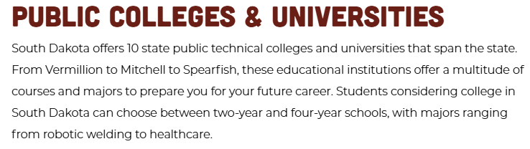
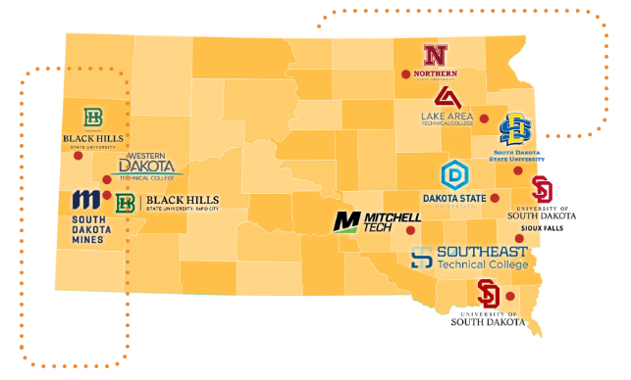
Learn About Options:
Black Hills State University (Spearfish or Rapid City)
Dakota State University
Lake Area Technical College
Mitchelle Technical College
Northern State University
South Dakota Mines
South Dakota State University
South Dakota State University
University of South Dakota (Vermillion or Sioux Falls)
Western Dakota Technical College
https://ourdakotadreams.com/exploring-colleges/sd-public-colleges-and-majors/
Notes:
The SD Public Colleges & Majors drop down outlines the public technical colleges and universities in South Dakota.
In addition to location and a link to their website, the page give top ten academic programs at each school.

Slide 10

AVAILABLE RESOURCES:
College Admissions Visits to Your High School
Campus Tours and Tips to Making the Most of Your Visit
Things to Consider When Searching for a College
Taking Advantage of College Fairs
https://ourdakotadreams.com/exploring-colleges/finding-your-fit/
Notes:
The Finding Your Fit page provides resources to help students think through the college selection process.
It provides information about admissions visits, career fairs, and how to make the most of an in-person campus tour.

Slide 11

Highlights: Paying for College
Have a resource request?
LET US KNOW!
ourdakotadreams.com
Notes:
The Paying for College section has a wealth of information for students considering college.

Slide 12

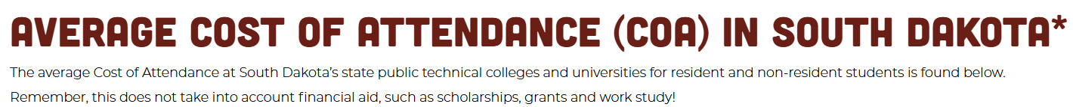
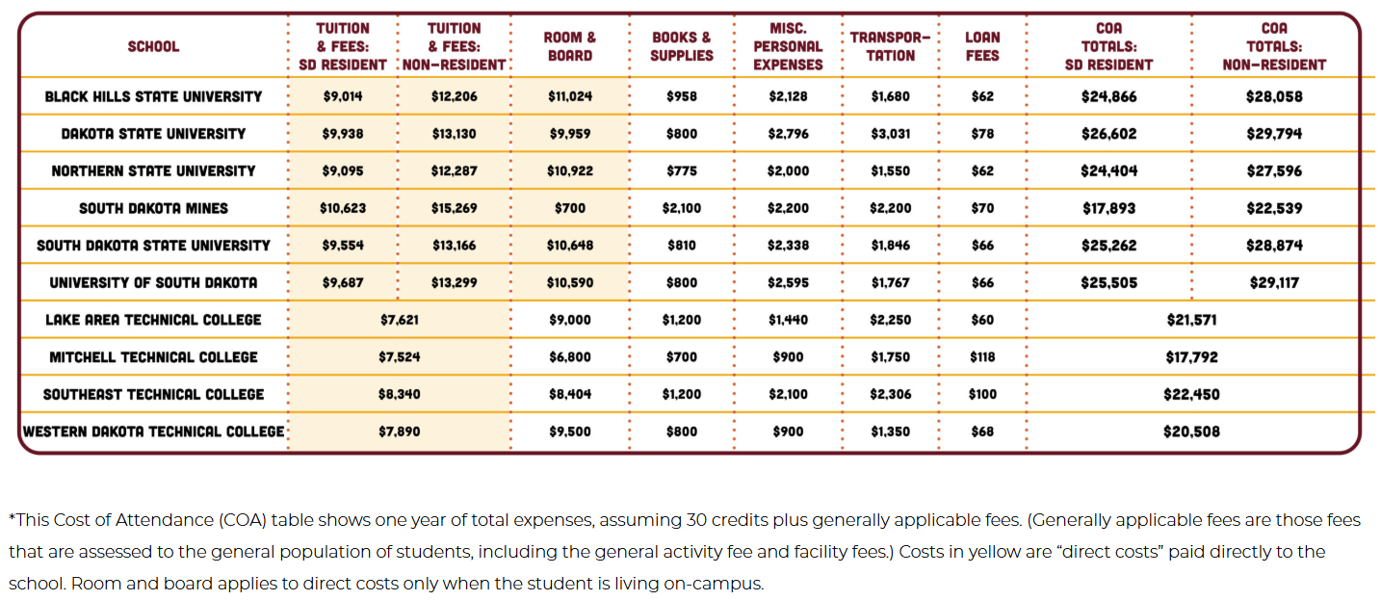
Have a resource request?
LET US KNOW!
https://ourdakotadreams.com/paying-for-college/cost-of-college/
Notes:
The Cost of College page breaks down the cost of attendance at public technical colleges and universities.

Slide 13
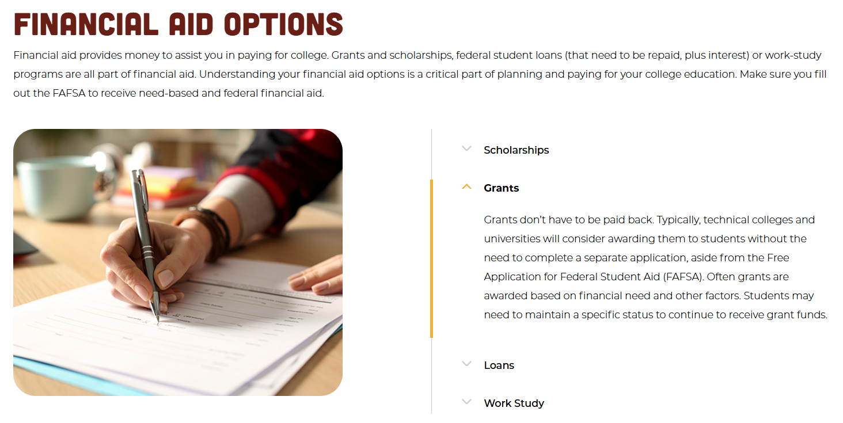
Have a resource request?
LET US KNOW!
https://ourdakotadreams.com/paying-for-college/financial-aid/
Notes:
The Financial Aid section provides a simplified explanation of financial aid options available to students.
As well as provides answers to common financial aid questions and contacts for college financial offices.

Slide 14

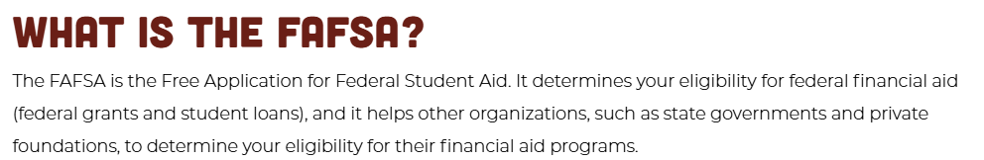

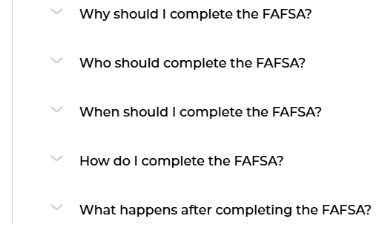

2026-2027 FAFSA Available Starting October 1!
https://ourdakotadreams.com/paying-for-college/financial-aid/completing-the-fafsa/
Notes:
It also emphasizes the important of Completing the FAFSA your senior year.
It’s important to know that the Free Application for Federal Student Aid (FAFSA) is the key to accessing financial aid.
Students should complete it as soon as possible after it opens October 1.
And the page entitled Completing the FAFSA on ourdakotadreams.com provides the who, what, when and where of FAFSA completion.
Including “how-to” videos recorded by SD non-profit Mapping Your Future.

Slide 15
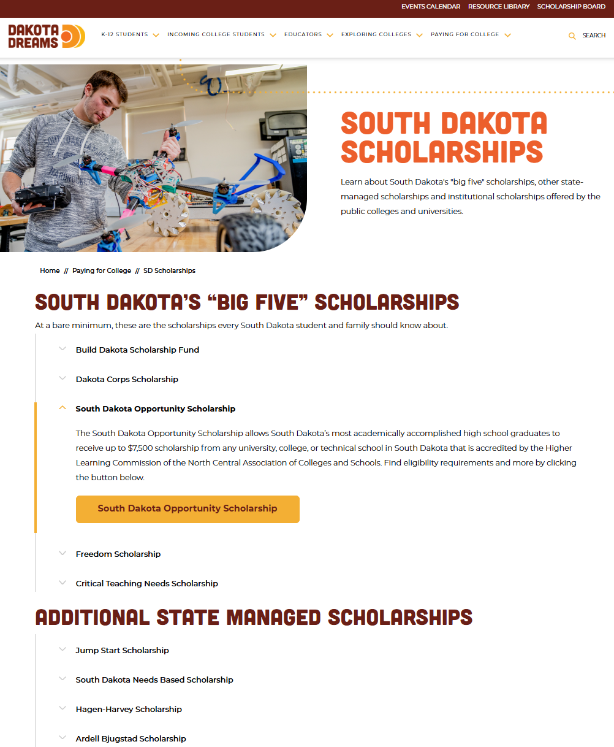
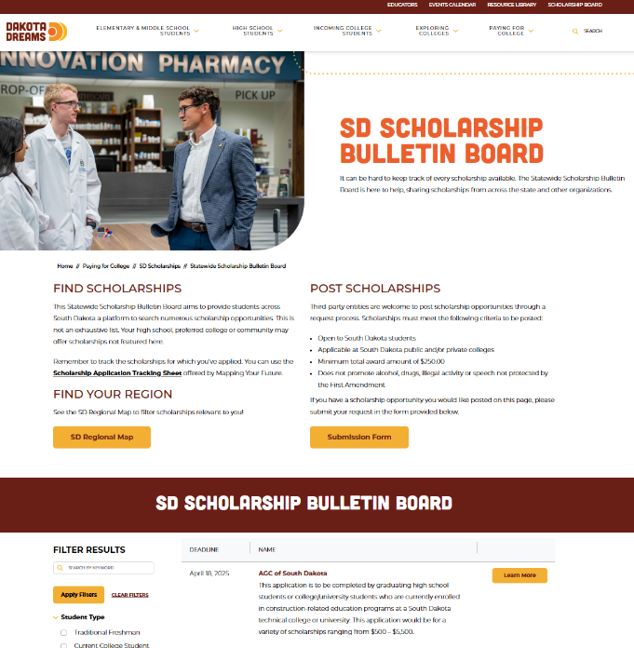
OurDakotaDreams.com
Notes:
The Paying for College section also outlines scholarship programs that all South Dakota students should be aware of.
Such as the SD Opportunity Scholarship that provides up to $7,500 to eligible students. (Find new, student-friendly SDOS webpage by clicking the button under the SD Opportunity Scholarship tab)
Students should also be aware of SD Statewide Scholarship Bulletin Board on ourdakotadreams.com to find scholarship opportunities available to them.

Slide 16

YOUR GUIDE TO COLLEGE & BEYOND
ourdakotadreams.com
Notes:
Find all this – and much more – at ourdakotadreams.com.

