Slide 1


SOUTH DAKOTA OPPORTUNITY SCHOLARSHIP
2025-2026

Slide 2
TOPICS
Our Dakota Dreams Introduction
South Dakota Opportunity Scholarship Overview
Initial Eligibility Requirements
Application, Deadline, Evaluation Process
Questions

Slide 3


COLLEGE PREP IN SOUTH DAKOTA
Our Dakota Dreams
audiences: students, families, educators
What is Dakota Dreams?
Our Dakota Dreams is the premier source for college preparation in South Dakota. The effort is led by a coalition of stakeholders with the goal of supporting students, parents, and advisors as they navigate their way toward college.
Notes:
Our Dakota Dreams is the premier source for college prep information in SD for students/families and their advisors.
Our Dakota Dreams is an effort led by a coalition of stakeholders with representatives from:
BOR & state public universities
State’s technical colleges
SD Department of Education
Non-profit Mapping Your Future
SD Department of Labor & Regulation

Slide 4
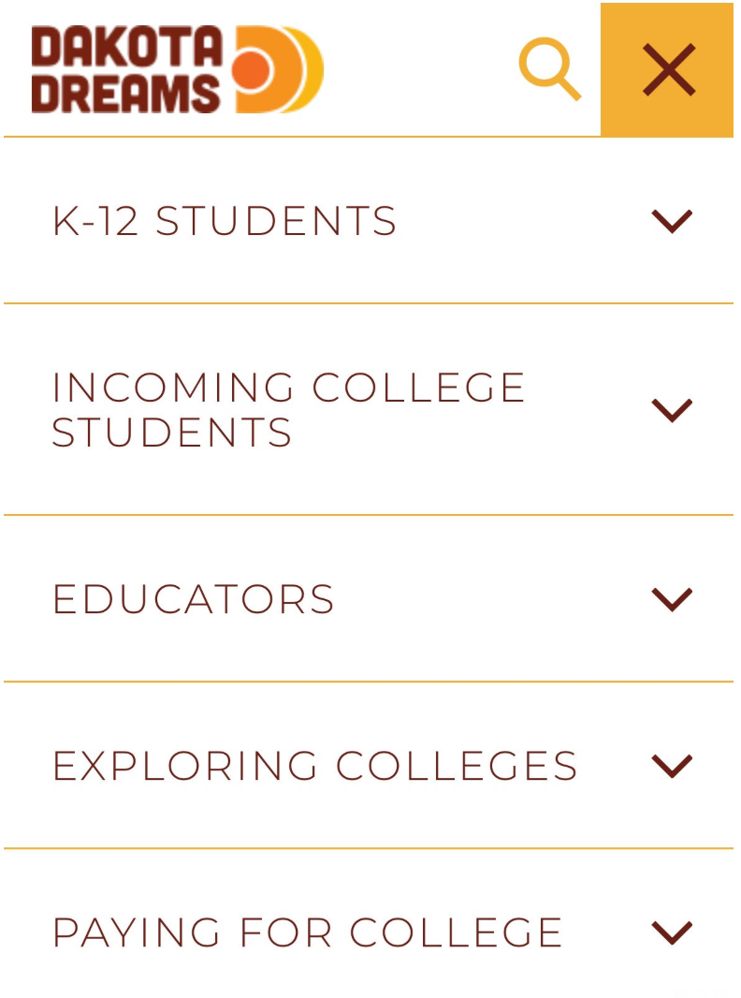
OUR DAKOTA DREAMS
Resources found on OurDakotaDreams.com
Grade-by-grade college preparation checklists
Dual credit & college readiness coursework
College and career exploration resources
Cost of college & financial aid information
SD Scholarships & Statewide scholarship bulletin board
Math Pathways advising tools
And more
Notes:
Our Dakota Dreams
Provides website resources on ourdakotadreams.com
Just a few of these website resources include:
Grade-by-grade college preparation checklists
Dual credit & college readiness coursework
College and career exploration resources
Cost of college & financial aid information
SD Scholarships & Statewide scholarship bulletin board
New math pathways advising tools
And more

Slide 5
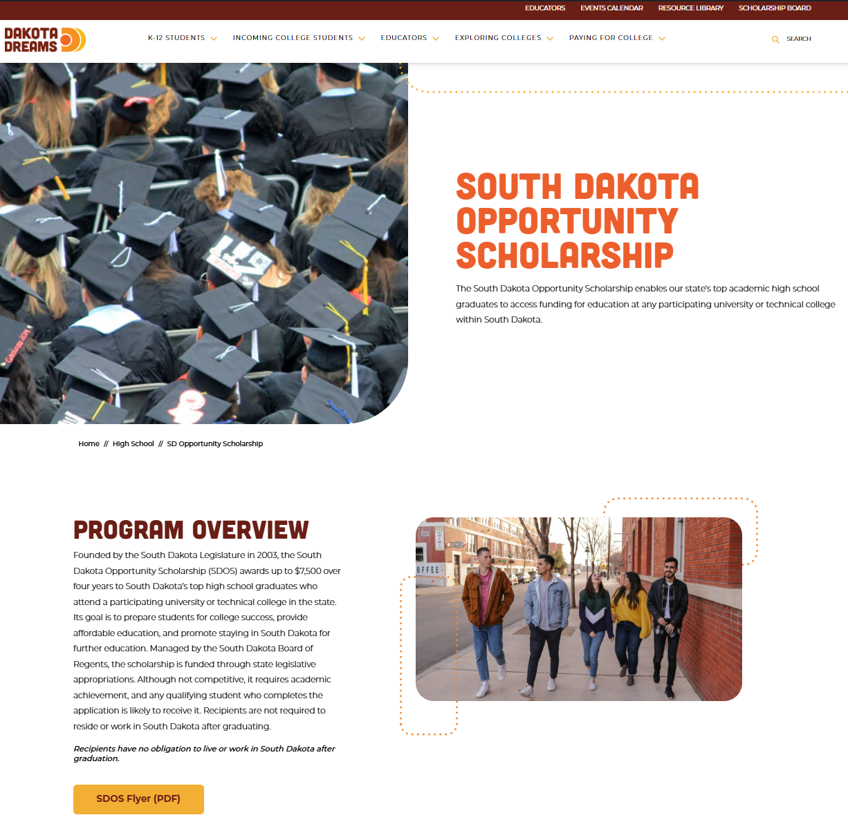
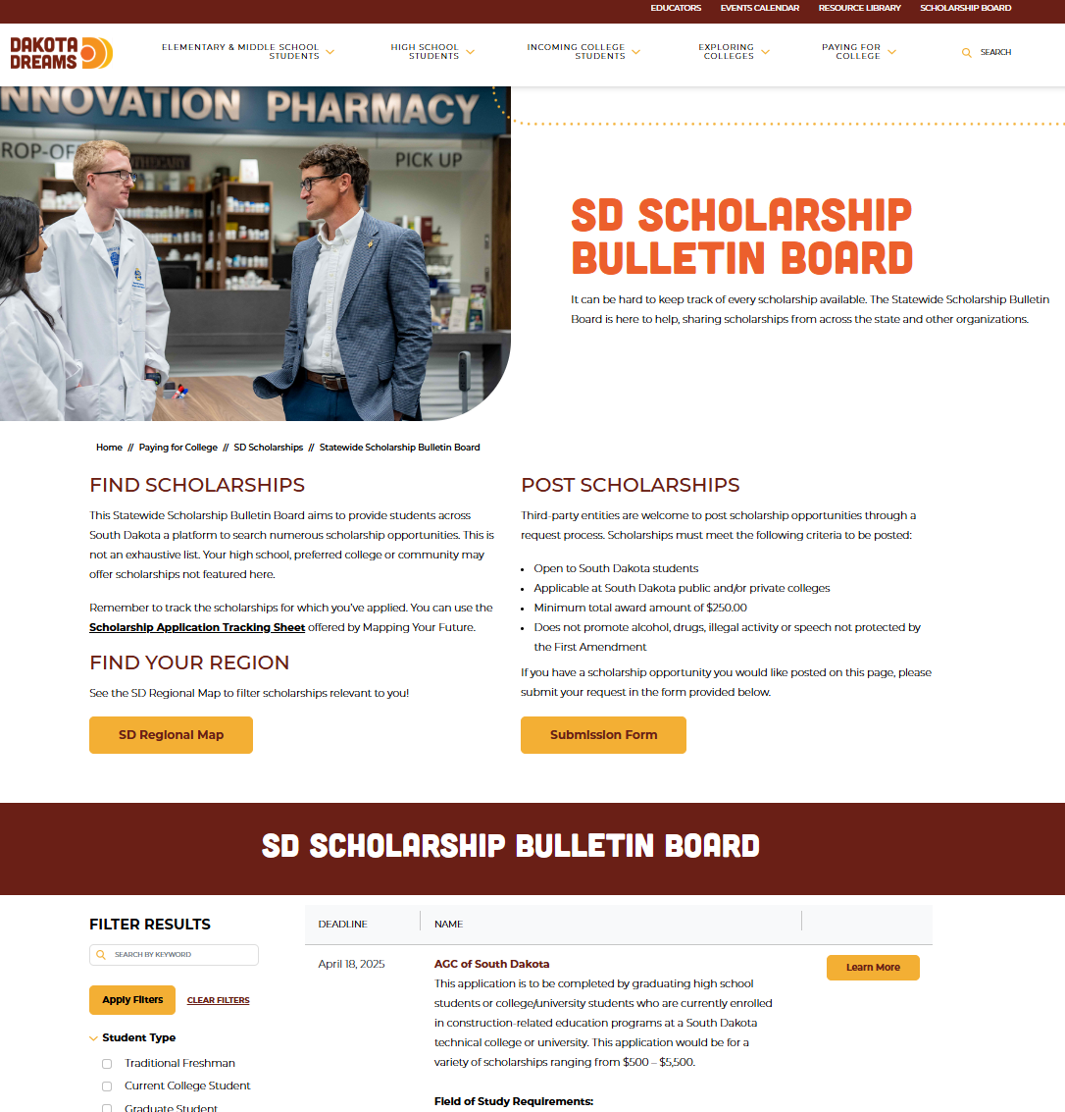
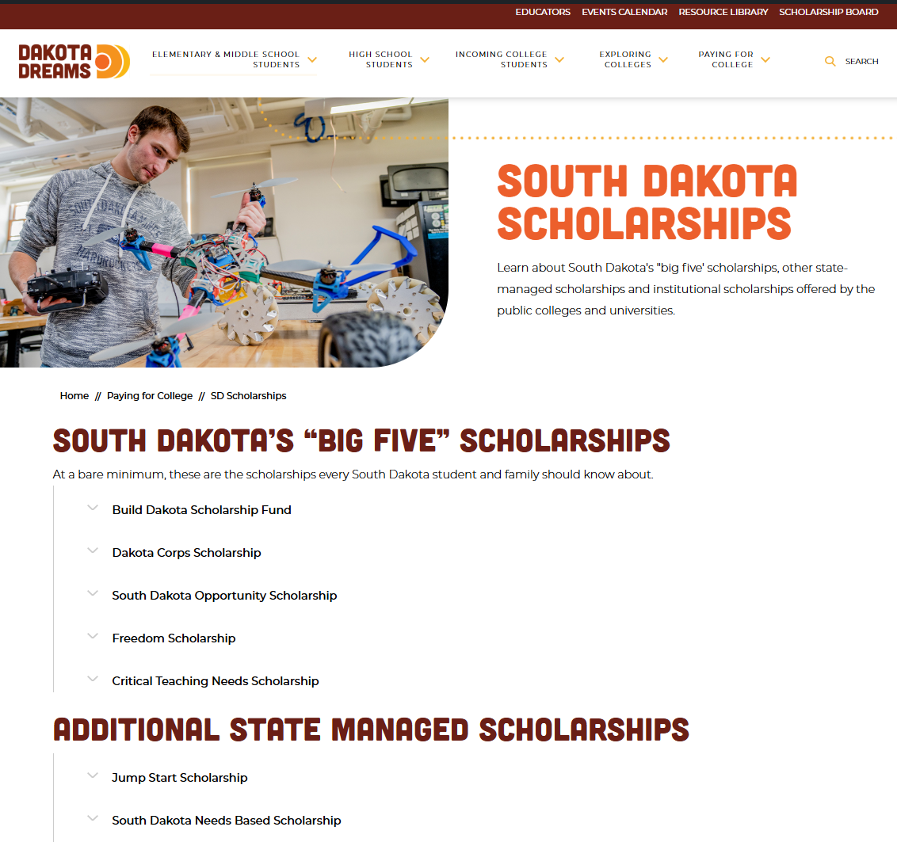
Scholarship Information OurDakotaDreams.com
Notes:
There are scholarship-specific resources on the Our Dakota Dreams website.
These include:
A page on SD Scholarships, which provides more information on SD’s “Big Five” scholarships, as well as other state managed scholarships, institutional scholarships and more.
A page specifically devoted to information about the SD Opportunity Scholarship.
And a SD Scholarship Bulletin Board where you can search for scholarship opportunities.
Go to ourdakotadreams.com and
Toggle to the Paying For College menu item to find this information.

Slide 6
IS SDOS A COMPETITIVE SCHOLARSHIP?
WHAT IS THE SOUTH DAKOTA OPPORTUNITY SCHOLARSHIP (SDOS)?
Established by the South Dakota Legislature in 2003
Purpose is to help SD graduates:
Prepare for success in college
Receive affordable education
Encourage them to attend college in SD
Funded by legislative appropriation
Codified Law 13-55-30 | South Dakota Legislature
No, all students who meet the eligibility requirements and complete application procedures can expect to receive the SDOS.
Notes:
What is the SD Opportunity Scholarship?
Scholarship establish by the legislature in 2003
And the purpose of the scholarship is to:
help SD graduates prep for success in college
receive affordable education
encourage graduates to stay in SD for college
Funds for the scholarship come from legislative appropriation
Is it a competitive scholarship?
No, while the scholarship requires rigor, any student who meets eligibility and completes the application can expect to be awarded

Slide 7
WHAT DOES AN SDOS AWARDEE RECEIVE? CODIFIED LAW 13-55-33 | SOUTH DAKOTA LEGISLATURE
AWARDEES ARE ELIGIBLE TO RECEIVE UP TO $7,500 OVER 8 TERMS :
Year 1 of attendance
Term 1, FALL - $750
Term 2, SPRING -$750
Year 2 of attendance
Term 3, FALL - $750
Term 4, SPRING - $750
Year 3 of attendance
Term 5, FALL - $750
Term 6, SPRING - $750
Year 4 of attendance
Term 7, FALL - $1,500
Term 8, SPRING - $1,500
“A student is eligible to participate in the South Dakota Opportunity Scholarship program for the equivalent of four academic years (eight consecutive spring and fall terms) or until the attainment of a baccalaureate degree, whichever comes first.”
Codified Law 13-55-31 | South Dakota Legislature
Notes:
So how much money does an SDOS awardee receive?
Awardees are eligible to receive up to $7,500.
Half of the annual award amount is paid to the student in Fall, the other half in Spring, which is dictated by SDCL 13-55-33
Notice the 7th and 8th terms are double the annual award amount than the prior three years.
Per statute, students are eligible to participate for 4 academic years, 8 consecutive spring and fall terms, or attainment of bachelor's degree, whichever comes first.
So, if a student is pursing an associates degree, it’s likely that they will only receive the first two years of the program, unless they chose to continue their education in some way at a participating school.

Slide 8
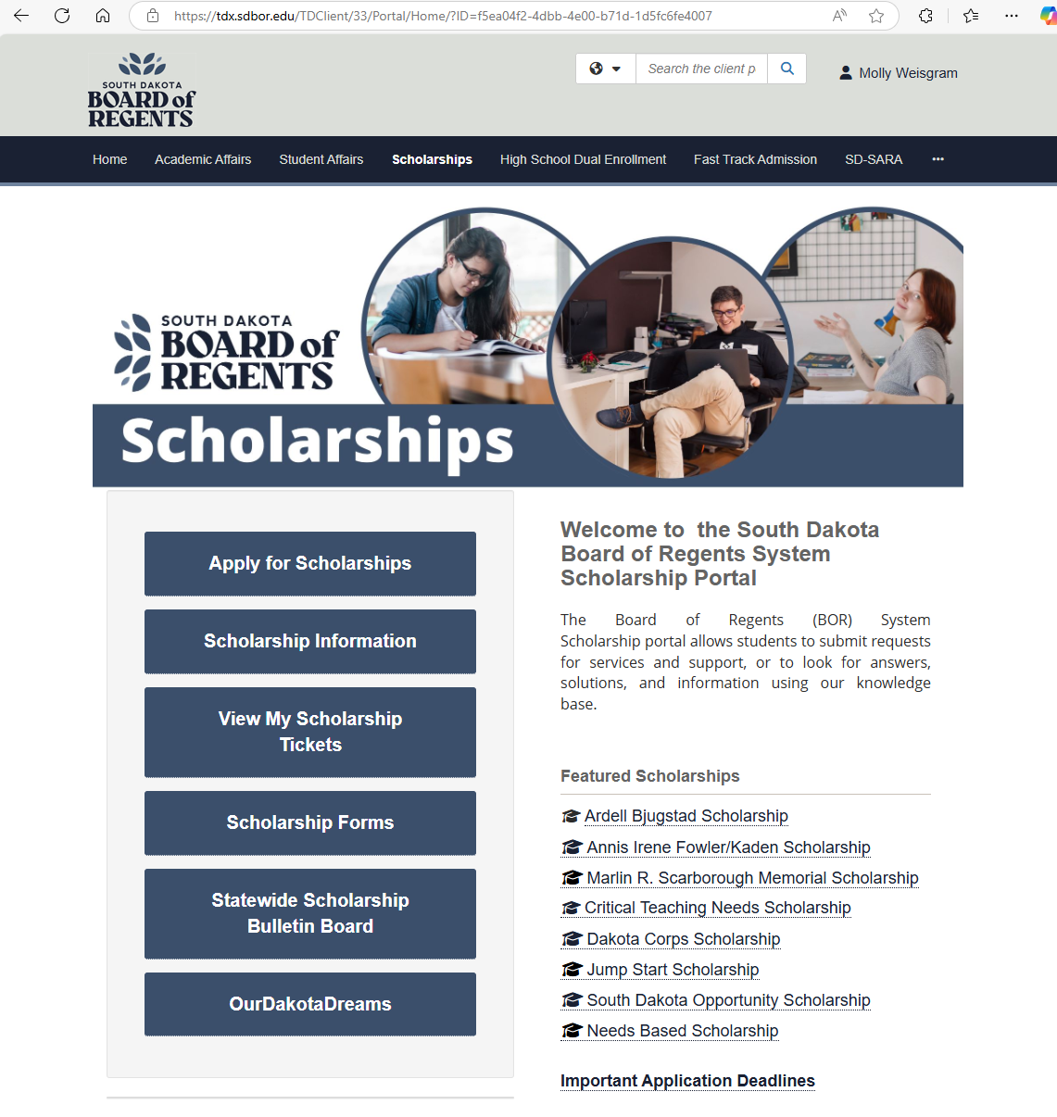
SCHOLARSHIP INFORMATION
Find information about scholarships managed by the BOR at: sdbor.edu/scholarships
Notes:
The South Dakota Board of Regents administers the SDOS
So you can find more in-depth information about this and other BOR managed scholarships on sdbor.edu/scholarships
Click on “Scholarship Information” which will take you to the page shown on the next slide

Slide 9
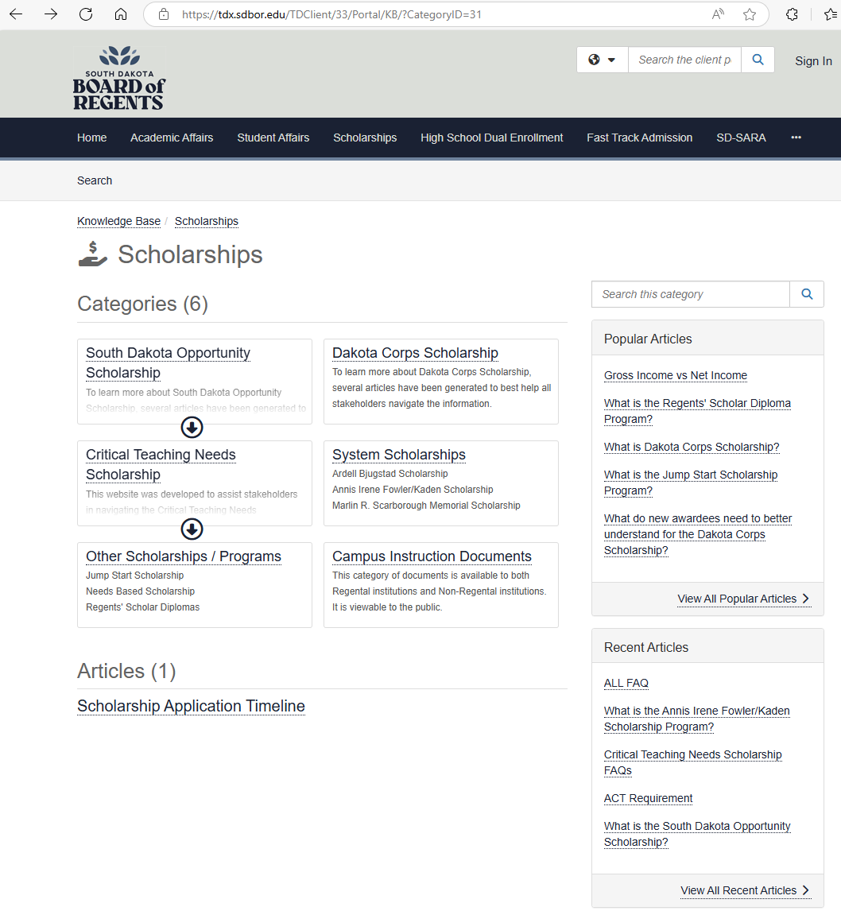
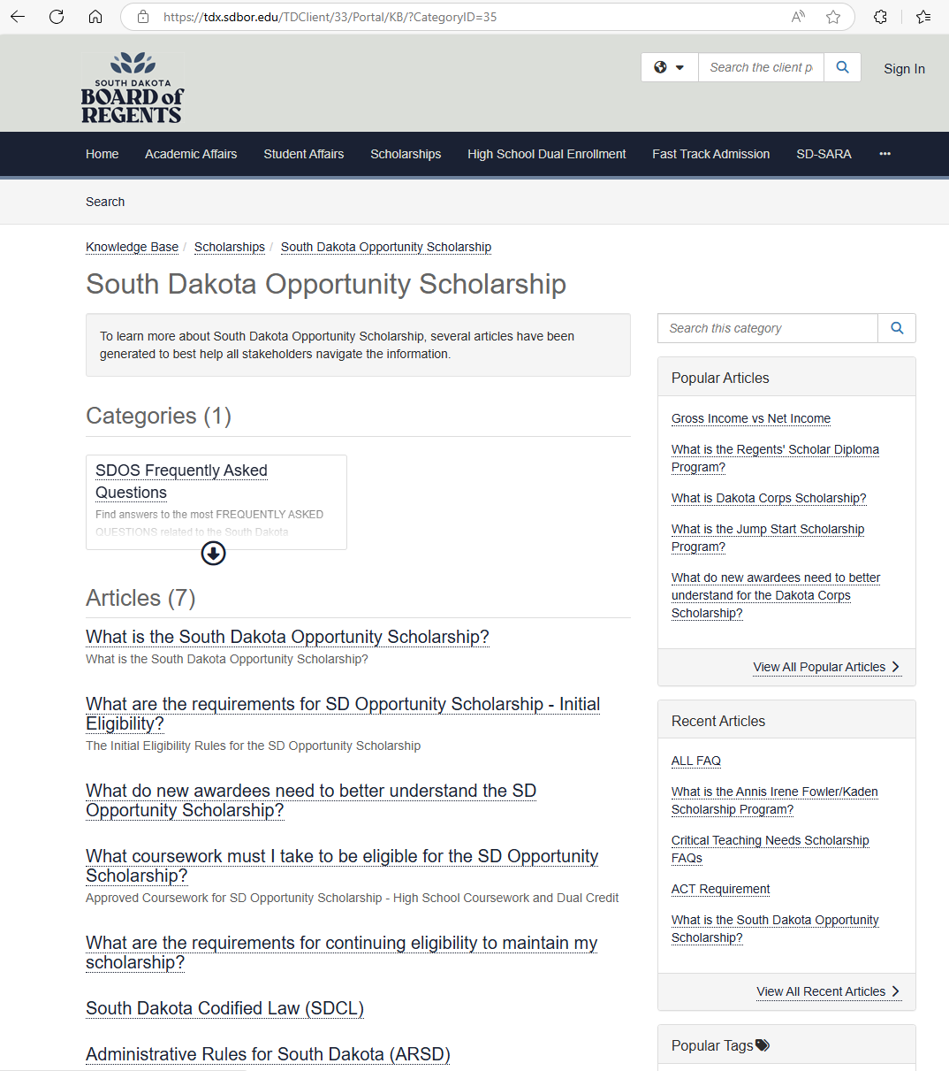
Agenda:
Introduction to SDBOR Scholarship Portal
Portal login information
Available applications
Scholarship deadlines
Notes:
On the left-hand image, you will see all scholarships managed by the BOR
But for today’s topic, you will click on the SDOS as shown, and it will take you to the image on the right
This page serves as the knowledge base for the SDOS, including a complete list of FAQs

Slide 10
WHAT ARE THE INITIAL ELIGIBILITY REQUIREMENTS OF SDOS? Codified Law 13-55-31 | South Dakota Legislature
OPTION 1:
South Dakota Resident
Attend a participating school
Within 5 years of HS graduation
Minimum ACT Composite or Super Score of 24 or higher
Unweighted GPA of 3.0 on a 4.0 scale
Curriculum Requirements (final grade cannot be below “C”)
OPTION 2:
South Dakota Resident
Attend a participating school
Within 5 years of HS graduation
Minimum ACT Composite or Super Score of 28 or higher
Unweighted GPA of 3.0 on a 4.0 scale
Curriculum Requirements
Notes:
There are 2 paths a student can take to meet initial eligibility requirements, and the paths are very similar until we get to ACT scores.
At a high-level, though, students:
Must be SD resident
Attend a participating college within 5 years of HS graduation
Have a minimum ACT of 24
GPA of 3.0 on 4.0 scale
Take certain curriculum with no final grades below “C”
Notice if a student has an ACT of 28 or higher, they do not need to comply with GPA or curriculum requirements

Slide 11
RESIDENCY Codified Law 13-55-31 | South Dakota Legislature
SDOS ELIGIBILITY REQUIREMENTS:
SD Resident
Attend a participating school
Within 5 years of graduation
Minimum ACT Composite or Super Score of 24 or higher
GPA of 3.0 on a 4.0 scale
Curriculum Requirements (final grade cannot be below “C”)
Students must be considered a South Dakota resident at the time of high school graduation.
If the student’s address is not from South Dakota, they are not eligible, even if they attend a South Dakota high school.
If the student lives in South Dakota but attends a high school outside of the state, the student may still qualify.
Notes:
Let’s dive into each eligibility requirement a little more thoroughly.
First and foremost, they must be a resident of South Dakota to be eligible.
The key take-away with this is that if they reside in one of SD’s border states, even if they graduate from a SD high school, they do not meet the requirements for SDOS.

Slide 12
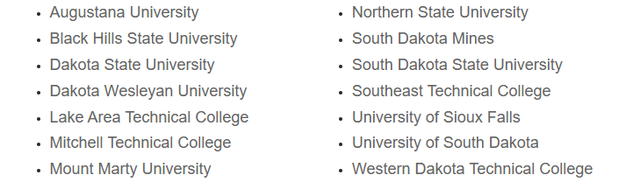
PARTICIPATING SCHOOLS
SDOS ELIGIBILITY REQUIREMENTS:
SD Resident
Attend a participating school
Within 5 years of graduation
Minimum ACT Composite or Super Score of 24 or higher
GPA of 3.0 on a 4.0 scale
Curriculum Requirements (final grade cannot be below “C”)
Attend a university, college, or technical school that is accredited by the North Central Association of Colleges and Schools and that provides instruction from a campus located in South Dakota. Codified Law 13-55-30 | South Dakota Legislature
Notes:
They must attend one of the participating colleges or universities within the state, which includes the regental universities, the technical colleges, and some of the private institutions in South Dakota.

Slide 13
ENROLLMENT WINDOW Codified Law 13-55-31 | South Dakota Legislature
SDOS ELIGIBILITY REQUIREMENTS:
SD Resident
Attend a participating school
Within 5 years of graduation
Minimum ACT Composite or Super Score of 24 or higher
GPA of 3.0 on a 4.0 scale
Curriculum Requirements (final grade cannot be below “C”)
Students must enter the scholarship program within five years of HS graduation.
Students can still receive the SDOS if they take a year(s) off before enrolling in their post-secondary education.
Students can still receive the SDOS if they attend an out-of-state school full-time and then return to an in-state school within two years of HS graduation.
Notes:
They must begin their enrollment within 5 years of HS graduation.
They can take a gap year and still be eligible, as long as they start school and apply for SDOS withing 5 years of HS graduation.
The are allowed to return to SD after attending an out-of-state school and still be eligible for the SDOS, as long as they return within two years of HS graduation.

Slide 14
ACT Codified Law 13-55-31 | South Dakota Legislature
SDOS ELIGIBILITY REQUIREMENTS:
SD Resident
Attend a participating school
Within 5 years of graduation
Minimum ACT Composite or Super Score of 24 or higher
GPA of 3.0 on a 4.0 scale
Curriculum Requirements (final grade cannot be below “C”)
OPTION 1:
ACT Composite or Super Score 24 or above
GPA of 3.0 or higher (on a 4.0 scale)
Requirement Curriculum
OPTION 2:
ACT Composite or Super Score 28 or above
SCORES DEFINED
Composite Score – Composed of all four subject’s average
Super Score – When taking the ACT more than once, the ACT will use the student’s highest score from each subject, combine and average them.
For SDOS eligibility, Super Score must be provided by ACT (cannot be manually calculated)
Notes:
Eligible students must have an ACT of 24 or above.
ACT is where the paths diverge.
If ACT composite or ACT superscore composite is a 28 or higher, the curriculum is not reviewed at all.
If the student has a 24 -27 composite score (either superscore or regular composite score), the BOR will review the transcript and look for the required coursework and GPA.

Slide 15
Current Sophomores, Freshman, and incoming (2027 graduates)
SDOS ELIGIBILITY REQUIREMENTS:
SD Resident
Attend a participating school
Within 5 years of graduation
Minimum ACT Composite or Super Score of 24 or higher
GPA of 3.0 on a 4.0 scale
Curriculum Requirements (final grade cannot be below “C”)
GPA
Students with an ACT of 24-27 must be graduated from high school with a cumulative average grade of "B" (3.0 on a 4.0 scale), or greater, for all work attempted and completed as designated on the official high school transcript at the time of graduation (ARSD 24:40:13:02)
Unweighted GPA is used to determine initial eligibility
Notes:
GPA is evaluated on a 4.0 unweighted scale.
The BOR will recalculate GPAs if they appear to be close.
When recalculating, they use a +/- scale, where an A is 4.0, A- is 3.67, B+ is 3.33, etc.

Slide 16
Current Sophomores, Freshman, and incoming (2027 graduates)
SDOS ELIGIBILITY REQUIREMENTS:
SD Resident
Attend a participating school
Within 5 years of graduation
Minimum ACT Composite or Super Score of 24 or higher
GPA of 3.0 on a 4.0 scale
Curriculum Requirements (final grade cannot be below “C”)
CURRICULUM REQUIREMENTS
Codified Law 13-55-31.1 | South Dakota Legislature
Students with an ACT of 24-27 are required to take approved coursework to meet SDOS eligibility
Class of 2026 –
Must meet requirements in various subject areas
Class of 2027 and Beyond –
Must meet requirements in the same subject areas as well as subcategories within those subject areas
Find SDOS approved high school and dual credit coursework here:
https://ourdakotadreams.com/high-school/opportunity-scholarship/
Notes:
Students with an ACT of 24-27 are required to take approved coursework to meet SDOS eligibility.
Any coursework used to meet SDOS curriculum requirements must have a grade of C or better. C- does not count.
The SDOS Approved Coursework guide can be found on the SDOS website. The BOR uses this document to determine whether student transcripts include the curriculum necessary to meet SDOS eligibility.
For the class of 2026 the BOR is only looking at the main subject areas and confirming that students have taken approved coursework that satisfies those subject areas. They are not looking for a specific number of courses from the subcategories.
Starting with the class of 2027, the BOR will be scrutinizing coursework to ensure that students are meeting all the subcategories within the subject areas.

Slide 17
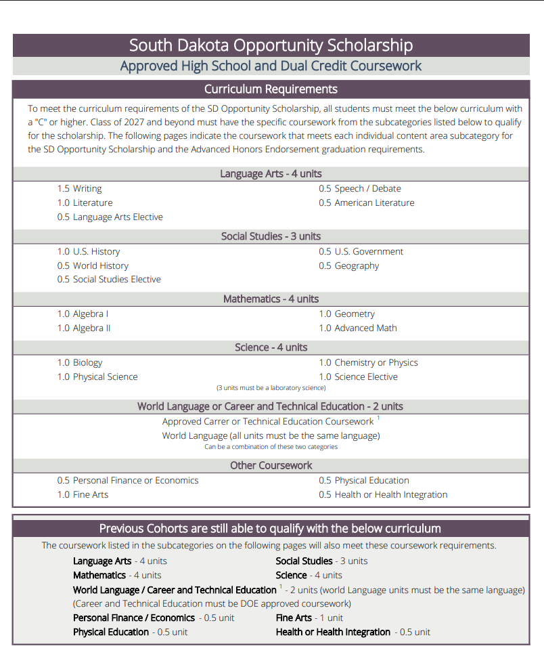
CLASS OF 2026
Must meet requirements in the following subject areas:
Language Arts – 4 units
Social Studies – 3 units
Math – 4 units (advanced)
Science – 4 units
World Language or CTE – 2 units
Personal Finance – 0.5 units
Fine Arts – 1 units
PE – 0.5 units
Health – 0.5 units
Notes:
These are the curriculum requirements for the class of 2026.
The image on the right-hand side of the screen shows the first page of the Approved SDOS Coursework Document.
The bottom portion outlines subject areas and required units for the class of 2026…no subcategories necessary.

Slide 18
CLASS OF 2027 AND BEYOND
Must meet requirements in the following subject areas AND subcategories:
Language Arts – 4 units total
1.5 Writing
1.0 Literature
0.5 Language Arts Elective
0.5 Speech / Debate
0.5 American Literature
Social Studies – 3 units total
1.0 US History
0.5 World History
0.5 Social Studies Elective
0.5 US Government
0.5 Geography
Math – 4 units total
1.0 Algebra I
1.0 Algebra II
1.0 Geometry
1.0 Advanced Math
Science – 4 units total
1.0 Biology
1.0 Physical Science
1.0 Chemistry or Physics
1.0 Science Elective
World Language or CTE – 2 units total
Personal Finance – 0.5 unit
Fine Arts – 1 unit
PE – 0.5 unit
Health – 0.5 unit
Notes:
However, for the class of 2027 and beyond, the BOR will be checking transcripts to ensure that students’ coursework fulfills all the required subcategories.

Slide 19
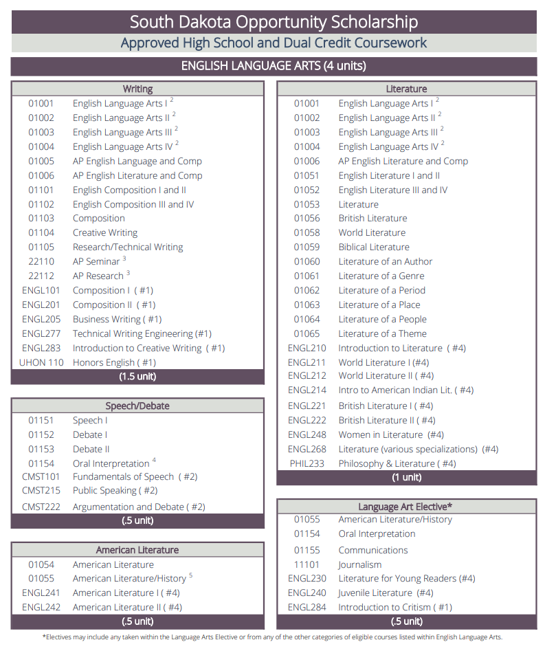
SUBCATEGORY EXAMPLE
Language Arts – 4 units
1.5 Writing
1.0 Literature
0.5 Language Arts Elective
0.5 Speech / Debate
0.5 American Literature
A course may only satisfy one category
Notes:
Example: the right-hand image shows the courses approved to meet the Language Arts subject area
The grey boxes show the subcategories that must be satisfied under English Language Arts.
The purple box underneath show the number of units required for that specific area.
One point I want to highlight – a course can only satisfy one subcategory.
Notice the course titled “01001 English Language Arts I” is listed under both the Writing and Literature subcategories.
But in can only be used to satisfy one of those subcategories. In other words, no double-dipping.
There are examples of this in several other subject areas, but the most common is Economics being used for Personal Finance. If the student takes Econ instead of a Personal Finance course, they cannot also use that same Econ course to meet part of the Social Science requirement.

Slide 20
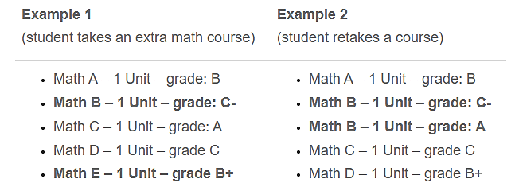
GRADE BELOW A “C” – REPEATING COURSES
Students must earn a “C” or higher on SDOS required coursework
They can have below a “C” in non-required courses (if it doesn’t adversely affect their GPA)
If a student earns below a “C” on a required course, they may retake it to get a better grade.
The examples below qualify for the SDOS math requirement since the students have 4 units above a “C”
Notes:
Students may have grades below a C on their transcript as long as their overall GPA still qualifies them for SDOS, but those courses may not be used to satisfy a SDOS requirement. If your school uses +/- grading, a C- is below a C and does not count.
Any course below C is not used to meet SDOS course requirements.
As shown in the examples on the screen, students who get less than a C in a eligible math course can either take an extra math course or retake a course to achieve the SDOS requirements.

Slide 21

Where to apply: Students apply for the SDOS through the SDBOR Scholarship Portal at sdbor.edu/scholarships.
HOW DO I APPLY FOR THE SDOS?
When to apply:
Traditional May graduates starting college in the fall semester should apply by the following:
Preferred – June 1
Deadline – September 1
Notes:
Now we are going to talk about applying for the SDOS.
Students apply through the SD Board of Regents scholarship portal at sdbor.edu/scholarship.
Traditional May graduates starting college in the fall semester should apply by the following:
Preferred – June 1
Deadline – September 1

Slide 22
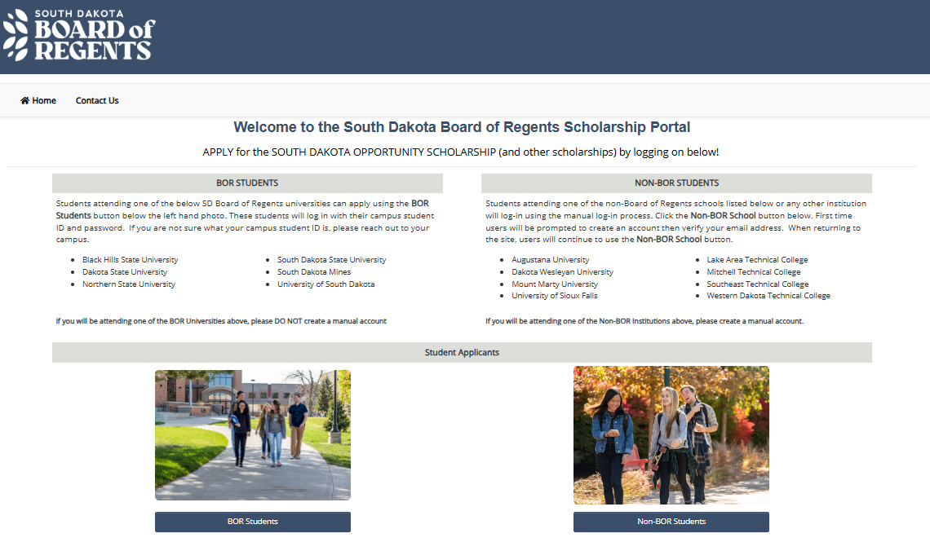
SDBOR SCHOLARSHIP PORTAL & LOGIN PAGE sdbor.edu/scholarships
Students with a BOR email address (because they took a BOR dual credit course or are an enrolled student) will enter through this button.
Students without a BOR email address (because they have not taken a BOR dual credit course or are an enrolled student) will enter through this button and create a manual account.
Notes:
Students can apply for SDOS (and other scholarships administered by the BOR) through the Scholarship Portal.
Go to sdbor.edu/scholarships and click on “Apply for Scholarships”
You will be brought to the screen on the right
Students with a BOR email address (because they took a BOR dual credit course or are enrolled at a BOR university) should enter through the button titled “BOR Students”
All other students should enter through the “Non-BOR Students” button

Slide 23
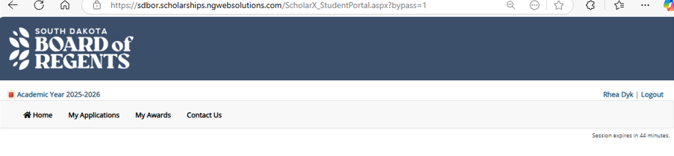
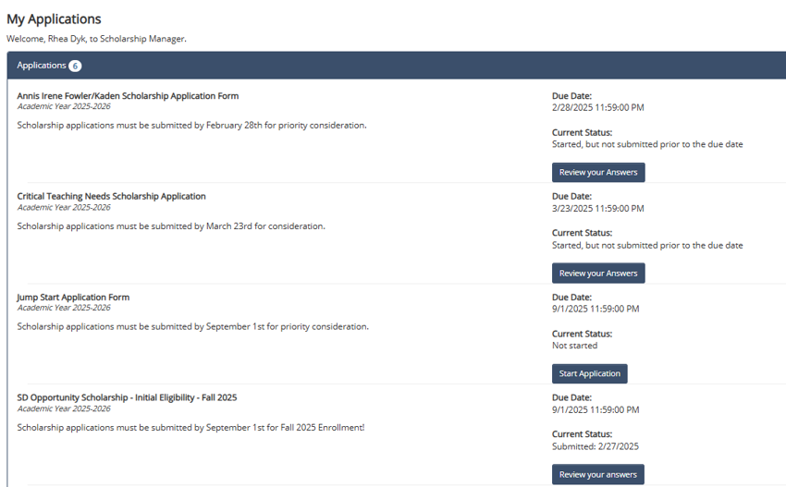
NAVIGATING TO THE SDOS APPLICATION
Once logged into the portal, available applications are listed in the “My Applications” tab on the student’s home page.
Traditional May graduates will apply using the application entitled:
SD Opportunity Scholarship
Click the application link and complete the application
Notes:
Once a student has logged into the Scholarship Portal, they will select “My Applications” to access the SD Opportunity Scholarship application.
They will click the button that says “Start Application” and complete/submit the app from there.
Once submitted, the application will be evaluated.

Slide 24
EVALUATION PROCESS
Evaluation is based on ACT scores and coursework grades found on the final OFFICAL transcript
Review starts June 1 and takes a large portion of the summer
Students who change their university choice after submitting the SDOS application should:
Communicate with the BOR scholarship staff
Send their OFFICIAL high school transcript to their university of choice
Ensure their most up-to-date ACT scores are sent to the university (if not on the transcript)
Awardees are notified in the Scholarship Portal, under “My Awards”, and via their institution’s financial aid office
Notes:
The evaluation is based on information from the OFFICIAL transcript and ACT scores
Reviews for fall awarding begin June 1 and take the majority of the summer, due to volume
Students who change their college or university of choice after submitting their SDOS application should:
Communicate with BOR staff so their award will be recognized by the correct school
Send their Official high school transcript to their new institution
Ensure their most up-to-date ACT scores are sent to their school of choice (if not on the transcript)
Awardees are notified of their award in the “My Awards” tab within the BOR portal; they will also hear from their institution’s financial aid office

Slide 25
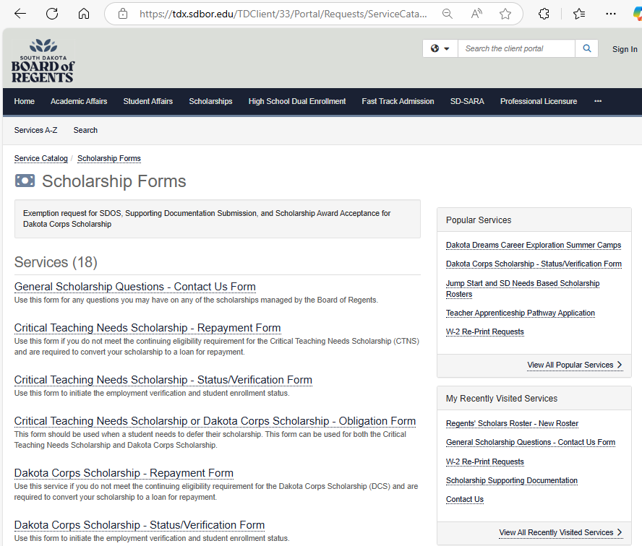
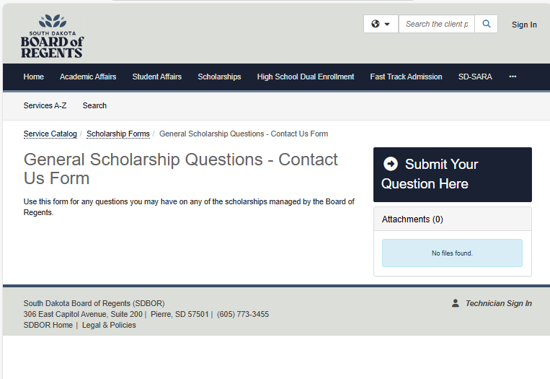
SDBOR SCHOLARSHIP - CONTACT US
Questions? Contact Us
Selected a College?
Once a student has been assigned an email at the SD college/university they will attend in the Fall, they should contact us to update their portal login.
Forgot your password?
BOR Students – Contact your university’s helpdesk to update your password
Non-BOR Students – Click “Forgot Password” on the login page
Notes:
The Board of Regents scholarship staff are here to support you through this process.
Submit a “Contact Us” at anytime.
While students may apply using one email, it is preferred that they contact the BOR to update their account information once they have been assigned an email address at their full-time institution
Additionally, students who forget their login password should either contact the university helpdesk if a “BOR Student” or click the ‘Forgot Password’ button on the login page when a Non-BOR Student
To submit a “Contact Us” form, students should:
Navigate to sdbor.edu/scholarships
Click the “Scholarship Forms” button
Select “General Scholarship Questions – Contact Us Form”
And then click the “Submit Your Questions Here” button

